Slide 1
MA1506 Mathematics II
Chapter 3
Mathematical Modelling

Slide 2
Introduction
mathematical model uses mathematical
language to describe a system.
In this module, we use ODE to describe some
systems.
In the last two chapters, we have studied
models for radioactive decay, falling objects,
cooling, mixture, radioactive decay chain,
harmonic oscillators, cantilevered beam, and
plug flow reactor
In this chapter, we will introduce three more
models.

Slide 3
Introduction
Three more models
Malthus model of population
Logistic growth model related
Harvesting model
Above models are 1st order ODE

Slide 4
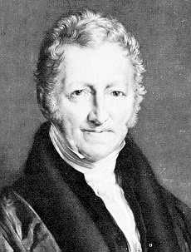
3.1 Malthus Model of Population pp1-6
Total population N(t) of a country is a function of time t
Thomas Malthus
1766 -1834
Here the unit of time is second
Given the initial population N(0) now,
can we predict what it will be in the future
Let look at
=Change in N during

Slide 5
3.1 Malthus Model of Population
We assume that no emigration or immigration
in this country, so
# of babies born during
# of deaths during
How to find # of babies and # of deaths
We compute as follows:

Slide 6
3.1 Malthus Model of Population
Let B(t) be per capita birth-rate,
i.e., B(t) is # of babies born per second,
divided by the total population of the country
at that moment t
B(t) depends on t, e.g. people might
gradually come to realise that large families
are no fun

Slide 7
3.1 Malthus Model of Population
B(t) depends on N(t) e.g., people might
realise that it is not good to have many
children on a small, crowded island
However in this model, we assume that
B(t) is constant, i.e., B(t)=B for all t
Hence
# of babies born during
B(t) = per capita birth-rate
http://www.indexmundi.com/g/r.aspx?v=25&l=en

Slide 8
3.1 Malthus Model of Population
In this model, similarly, we also assume that
per capita death-rate D is a constant.
# of deaths during
Hence we have
So
Hence

Slide 9
3.1 Malthus Model of Population
Let
Then
Hence

Slide 10
3.1 Malthus Model of Population
Let t=0, we get
So
k > 0 i.e., B>D: population explosion
k = 0 i.e., B=D: stable
k < 0 i.e., B<D: extinction
as
for all t
as

Slide 11
3.2 Logistic growth model pp 7-20
Logistic growth model was introduced by
Pierre Francois Verhulst in 1844
Logistic growth was coined by him
A growth is said to be a logistic growth
if the initial stage of growth is approximately
exponential;
then, as saturation begins, the growth slows,
and at maturity, growth stops.
stop
slow
fast

Slide 12
3.2 Logistic growth model
In Logistic growth model, one more condition was imposed as follows:
death rate is a function of population
where s is a very small value
This condition is called logistic assumption
This represents the idea that, in a world with
finite resources, large population will eventually
cause starvation and disease

Slide 13
3.2 Logistic growth model
First we shall roughly check that in this model,
the population growth is a logistic growth
At the initial stage, the term sN is small
compare with B. Hence we have
So
Therefore it grows exponentially at the very beginning

Slide 14
3.2 Logistic growth model
Now N continues to grow,
grows faster than N, we will
reach a point where
i.e.,
At this point, since
the population will stop growing
B/s
Stop growing
Initially grows
exponentially
Grow rate decreases

Slide 15
3.2 Logistic growth model
We remark that in the above discussion
We assume that at the initial stage,
sN is small compare with B
Suppose otherwise, B < sN
Then what happens?
We shall consider
this case when we solve the logistic ODE

Slide 16
3.2 Logistic growth model
Now we shall solve the above 1st order
ODE to get clearer picture of the population
growth
First note that the above ODE is 1st order
It is not linear ODE,
but it is separable
and it is Bernoulli

Slide 17
3.2 Logistic growth model
Notice that there exist
two equilibrium solns, i.e., constant solutions,
namely, N(t)=0 and N(t)=B/s for all t
The equilibrium soln B/s is very important, called carrying capacity, sustainable population, or logistic equilibrium population. Or we say that population stabilizes at B/s
Next we shall use separable method
to solve the above ODE, we assume that

Slide 18
3.2 Logistic growth model
separable
Use partial fraction method, get

Slide 19
3.2 Logistic growth model

Slide 20
Two cases
3.2 Logistic growth model
Case 1:
Population smaller than sustainable population
Case 2:
Population bigger than sustainable population
In this chapter, denote

Slide 21
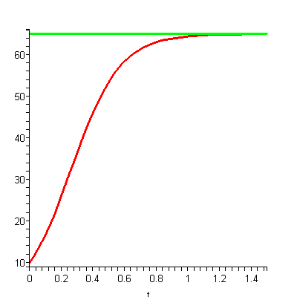
Case 1: B-sN(t)>0 i.e., B/s>N(t) for all t
3.2 Logistic growth model
We have
We assume initial condition
B/s
sustainable population
get
logistic curve increasing since
so
When t tends to infinity, N(t) tends to B/s

Slide 22
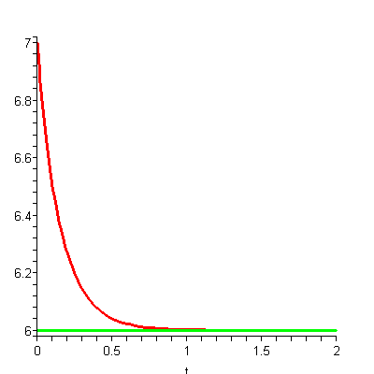
Case 2: B-sN(t)<0 i.e., B/s<N(t) for all t
3.2 Logistic growth model
We have
We assume initial condition
So get same soln (sure) as in case 1
logistic curve decreasing since
When t tends to infinity, N(t) tends to B/s
sustainable population
B/s

Slide 23
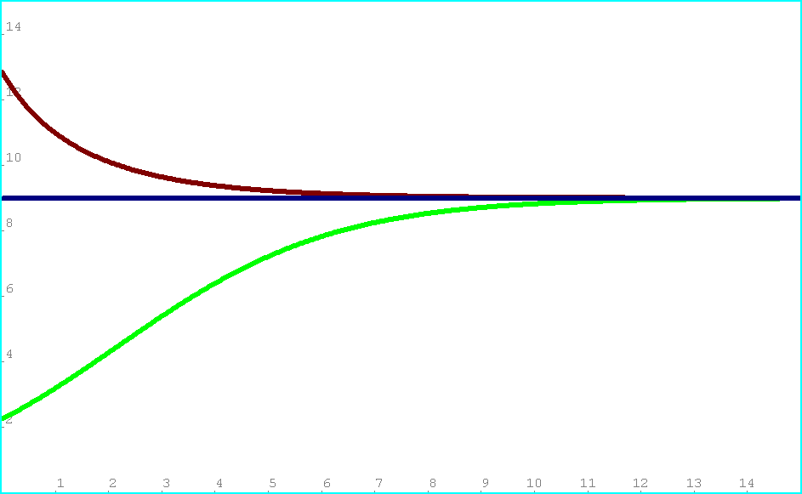
B/s
3.2 Logistic growth model
We have three types of solutions
Solution curve N(t) for N(t)>B/s for all t
sustainable population
Soln curve for
N(t)=B/s for all t
Soln curve N(t) for N(t)<B/s for all t

Slide 24
3.2 Logistic growth model
Do we have other types of solutions?
ANS: No
Now we shall point out why
First, look at the following three curves

Slide 25
3.2 Logistic growth model
Why any two of the above curves are
Not Crossing ( or Not Touching) each other?
Since, as mentioned in chapter one,
there is one and only one soln for initial value
problem for 1st order ODE
Suppose two curves are crossing. Then we can
use the intersection point as an initial point.

Slide 26
3.2 Logistic growth model
We see that if there are two curves starting from
this intersecting pt, it means that there
are two solutions with the same initial point.
It contradicts the fact that there is one and
only one solution if initial condition is given.
So we have the following no crossing principle;
Any two solution curves are Not Crossing (or
Not Touching) each other

Slide 27
3.2 Logistic growth model
By no crossing principle, every soln N(t)
does not cross the line N=B/s. Hence we
only have three situations
Curve always above line N=B/s
Curve always below line N=B/s
Curve is the line N=B/s
Therefore we only have three types of
solutions

Slide 28
3.3 No Crossing (Touching) Principle pp 21-24
Solution curves of ODEs should never cross, touch, each other.
We shall say more about this principle
in this section

Slide 29
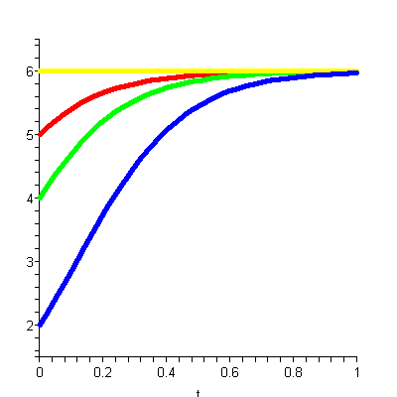
3.3 No Crossing (Touching) Principle
For example, in Logistic growth model
If N < B/s initially, soln curve never cross , touch B/s
Any two soln curves never cross, touch
B/s

Slide 30
B/s
3.3 No Crossing (Touching) Principle
Can we draw the following graph
without solving the above ODE?
Yes, we can
sustainable population

Slide 31
3.3 No Crossing (Touching) Principle
First , N=B/s is an equilibrium pt (solution)
Secondly, if N<B/s, then dN/dt is positive.
Hence N is increasing

Slide 32
3.3 No Crossing (Touching) Principle
Next, if N>B/s, then dN/dt is negative
Hence N is decreasing
So, by no crossing principle,
we have the graph
B/s
sustainable population
There is 2nd equilibrium soln (pt), where?

Slide 33
3.4 Harvesting pp24-38
A major application of modelling is in dealing
with populations of animals, e.g. fish
We want to know how many we can eat
without wiping them out
Let’s build on our logistic model

Slide 34
3.4 Harvesting
Assume fish population N follows
Logistic Growth Model
We assume one more condition that
we catch E (constant) fish per year.
Therefore we have
Basic Harvesting Model

Slide 35
How to solve
3.4 Harvesting
It is not easy. We need to use partial
Fraction of so need to consider
solutions of
There are three cases
One soln, Two solns, No solution
Different method for each case.
So in the following, we will not solve this
ODE
=0

Slide 36
3.4 Harvesting
In the logistic growth model, we observe
that EQUILIBRIUM SOLUTION plays
an important role. In this Harvesting
model, we shall use equilibrium solution
as a starting point (without solving ODE)
and then using no crossing principle to
sketch the solution curves

Slide 37
3.4 Harvesting
First find equilibrium solutions.
For convenience, let
Then
N(t) is an equilibrium soln iff N(t) is constant,
iff
iff

Slide 38
3.4 Harvesting
N is an equilibrium solution
if and only if F(N)=0
where

Slide 39
3.4 Harvesting
There are three cases determined by
Case 1
No equilibrium soln
Case 2
Two equilibrium solns
Case 3
One equilibrium soln
Now, for each case, we shall use
no crossing principle to sketch the soln curves

Slide 40
Case1
3.4 Harvesting
No equilibrium soln
First note that –s is negative, so the curve of F(N)
looks like
Not look like
Secondly, F(N) never equal zero for this case, so
the curve of F(N) looks like

Slide 41
Case1
3.4 Harvesting
No equilibrium soln
F(N)
Hence F(N)<0
So
N
So population N is
decreasing

Slide 42
Case1
3.4 Harvesting
No equilibrium soln
Population N is decreasing
Fishermen will wipe out fish in this case
i.e.
N
Recall E= # of fish caught per year
t

Slide 43
Case 2
3.4 Harvesting
i.e.
Two equilibrium solutions
Recall
So If
, then F(N)=0 has two solns
These two solns are
our two equilibrium solutions
namely

Slide 44
Case 2
3.4 Harvesting
where

Slide 45
3.4 Harvesting
N

Slide 46
Case 2
3.4 Harvesting
From no crossing principle, there are three cases.
Soln curves above the line N=
Soln curves are decreasing
Soln curves between the line N=
and the line N=
Soln curves are increasing
Soln curves below the line N=
soln curves are decreasing

Slide 47
3.4 Harvesting
N
B/s
-
equi soln stable
Good region
able to bounce back
equi soln unstable
t

Slide 48
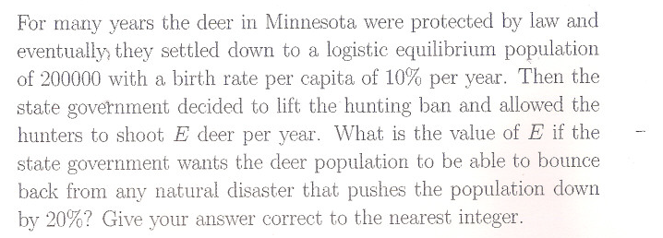
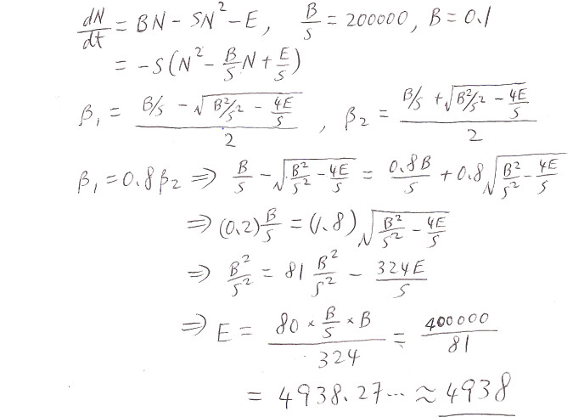
3.4 Harvesting
B/S

Slide 49
Case 2
3.4 Harvesting
Properties of these two equilibrium solutions
and are equilibrium solutions. BUT there is a vast difference between them
is stable. If N(0) is slightly diff from
then population will still tend to
is not stable. If N(0) is slightly diff from , then population will not tend to ,see chapter two for stability

Slide 50
Case 3
3.4 Harvesting
One equilibrium solution
has only one soln
(Equilibrium soln)
Hence
So N is decreasing

Slide 51
3.4 Harvesting
By no crossing principle,
we have
N
Equi soln
unstable
t

Slide 52
Summary: Soln curves for three cases
3.4 Harvesting
More precise soln curve
looks like
Case 1:
N
why?
We shall discuss noon
t
However very often,
we don’t need such
precise curve

Slide 53
3.4 Harvesting
Case 2:
N
B/s
--
More precise curve
t

Slide 54
3.4 Harvesting
Case 3:
N
Equi soln
unstable
t

Slide 55
3.4 Harvesting
Two remarks
Remark 1:
More precise soln curve
For case 1, more precise curve looks like
Why?
From calculus, we know that
if we want to sketch more precise curve,
we need to discuss concave up ,
concave down and pt of inflection

Slide 56
3.4 Harvesting
Recall in case 1,
To discuss pt of inflection, we compute
Let
get

Slide 57
3.4 Harvesting
Now check whether
is pt of inflection
Look at
concave down
concave up
Pt of
inflection

Slide 58
3.4 Harvesting
pt of inflection B/2s
N>B/2s
Concave down
Concave up
N<B/2s
However you don’t need to draw such precise
soln curve, unless you are asked to do so

Slide 59
How to find Extinction Time T
3.4 Harvesting
Remark 2:
where

Slide 60
3.4 Harvesting
First consider
CASE 2: F(N)=0 has two solns
How to integrate? Partial fraction.

Slide 61
3.4 Harvesting
Now consider
CASE 3: F(N)=0 has one soln
It is Not difficult to compute the above integral

Slide 62
3.4 Harvesting
Finally consider
CASE 1: F(N)=0 has NO soln
We can’t factorize
Change the above integral to
the following form
End
Chapter three

